Slide 1
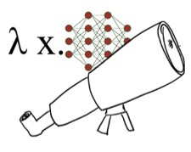

Neurosymbolic Programming and Scientific Discovery
Atharva Sehgal
atharvas@utexas.edu
Notes:
Broader takeaways:
- code can serve as a common representation for expressing novel facts.

Slide 2
Outline of this Talk
Scientific Discovery
Symbolic Regression
Symbolic Regression with a Concept Library (NeurIPS’24)
Visual Reasoning
Self-Evolving Visual Concept Library using Vision-Language Critics (CVPR’25)
Discussion
Notes:
I’ve structured this talk into four sub parts
The scientific discovery problem is a bit different from the general theorem proving formulation so I want to spend some time motivating scientific discovery and talk about the kind of program synthesis search algorithms in this space. (10 min)
Next, I want to talk about one way of guiding the symbolic search with LLMs. ( 15 min)
We’ll talk a little bit about some ongoing work on visual reasoning with neurosymbolic program (5 min)
And I’ll take questions at the end (10 min)

Slide 3

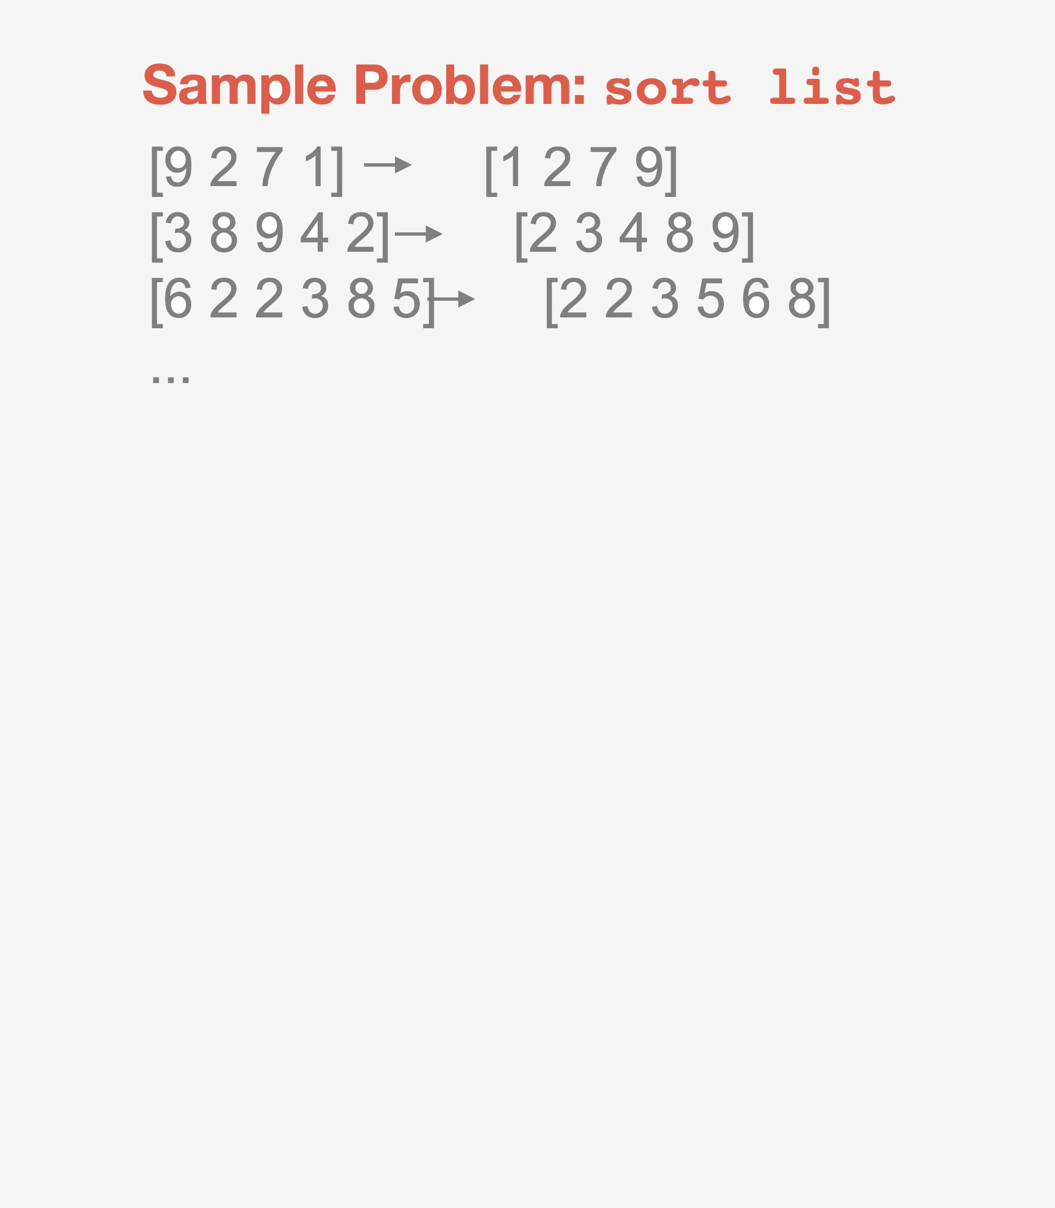
Library Learning in Dreamcoder
Ellis, Morales, Sable-Meyer, Solar-Lezama, Tenenbaum. NeurIPS 2018.
Ellis, Wong, Nye, ..., Solar-Lezama, Tenenbaum. 2020.

Slide 4
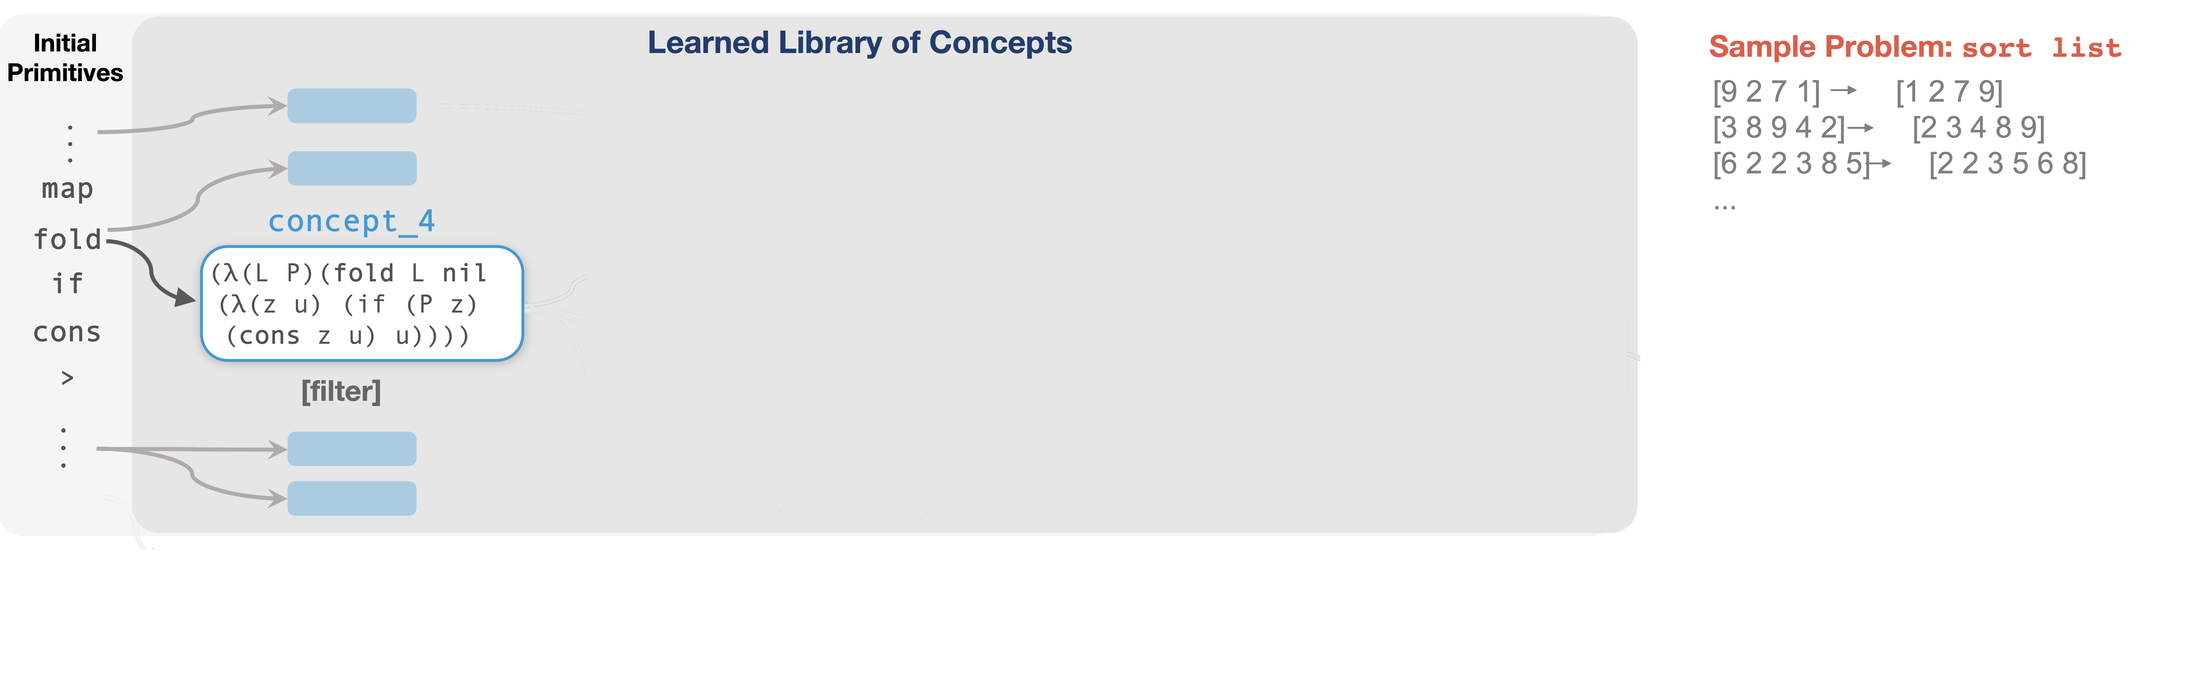
Library Learning in Dreamcoder

Slide 5
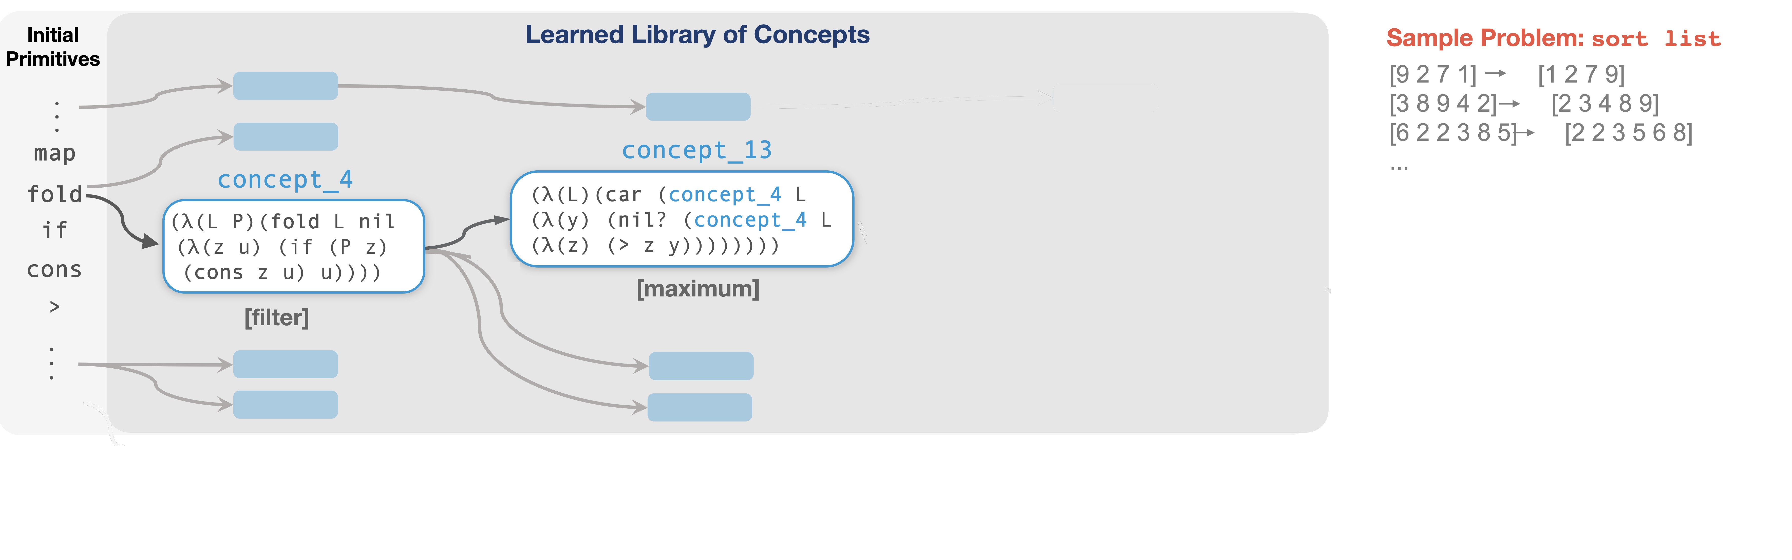
Library Learning in Dreamcoder

Slide 6
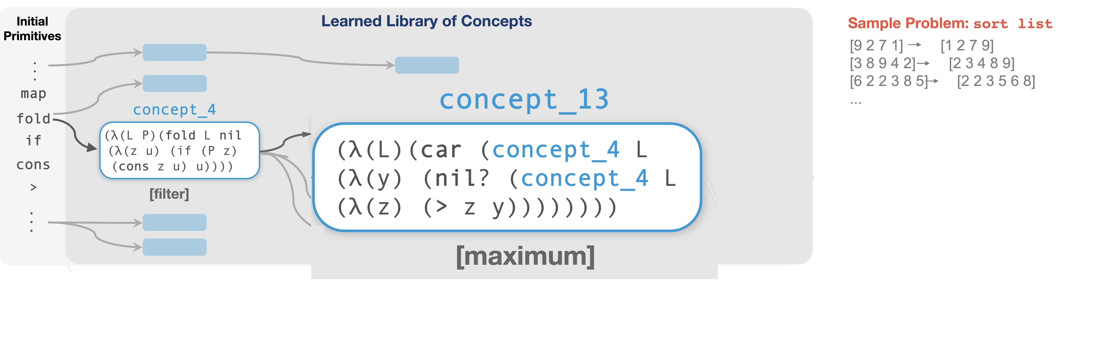
Library Learning in Dreamcoder

Slide 7
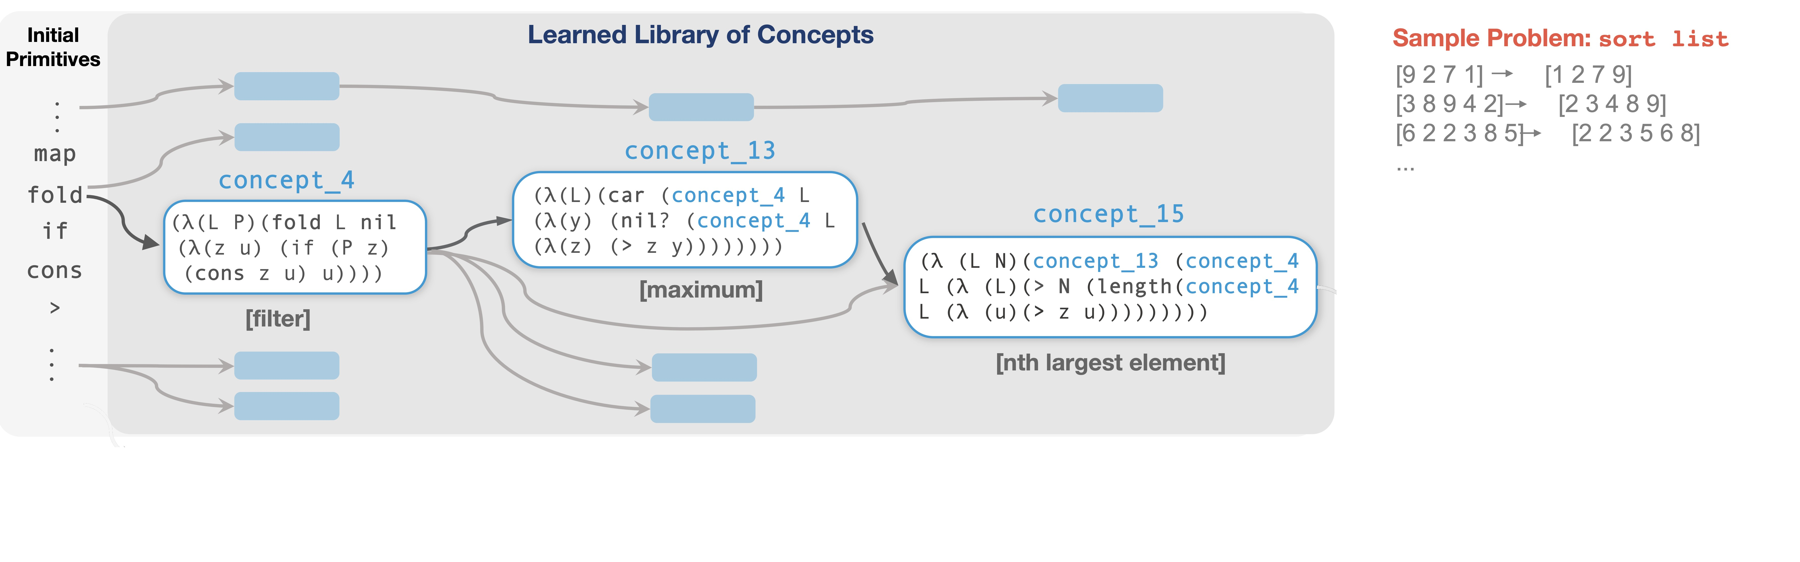

Slide 8
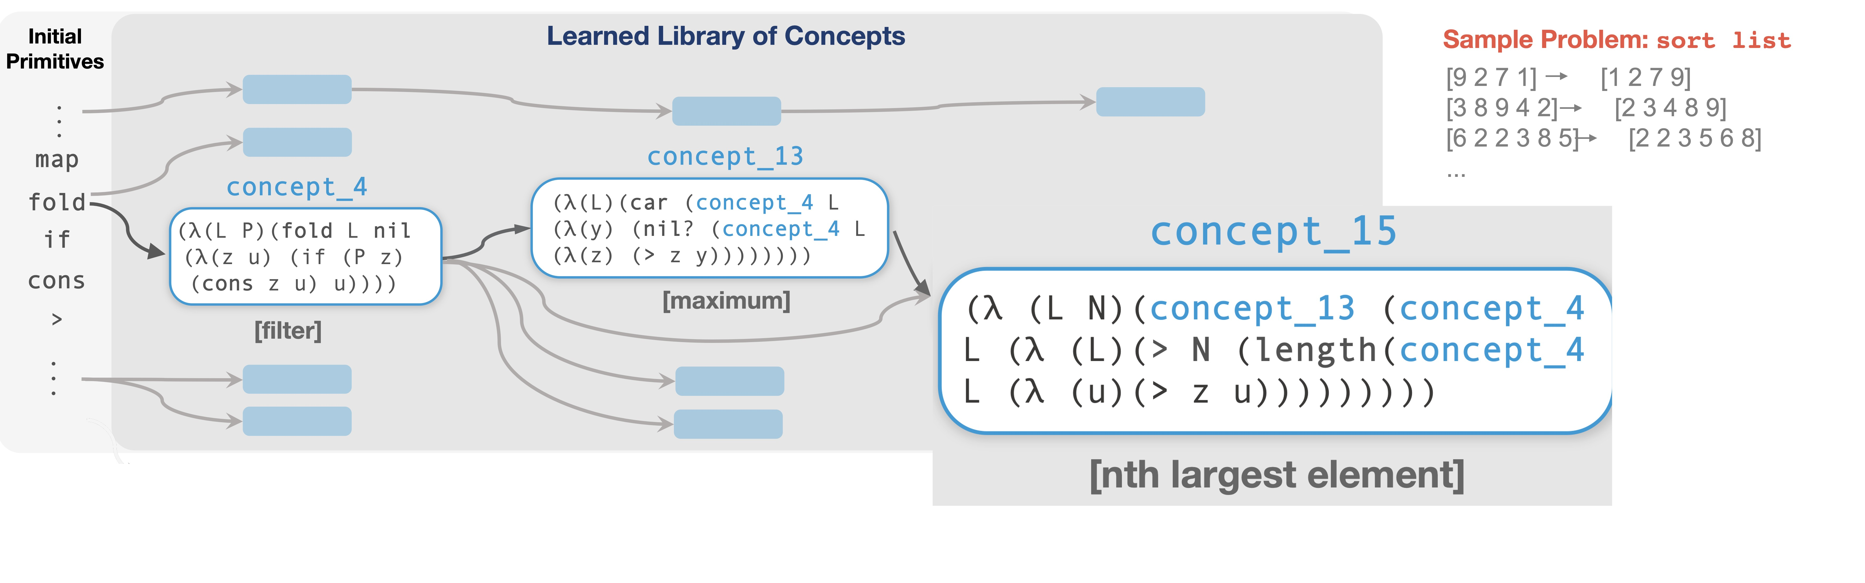
Library Learning in Dreamcoder

Slide 9
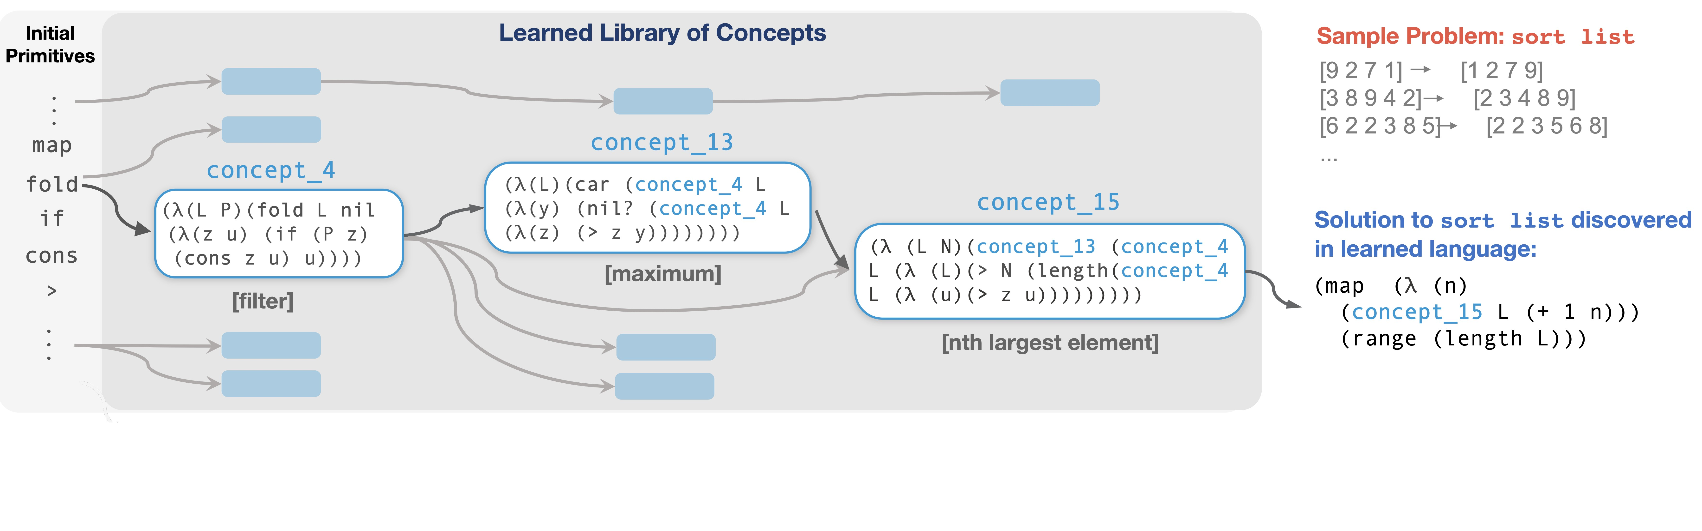
Library Learning in Dreamcoder

Slide 10
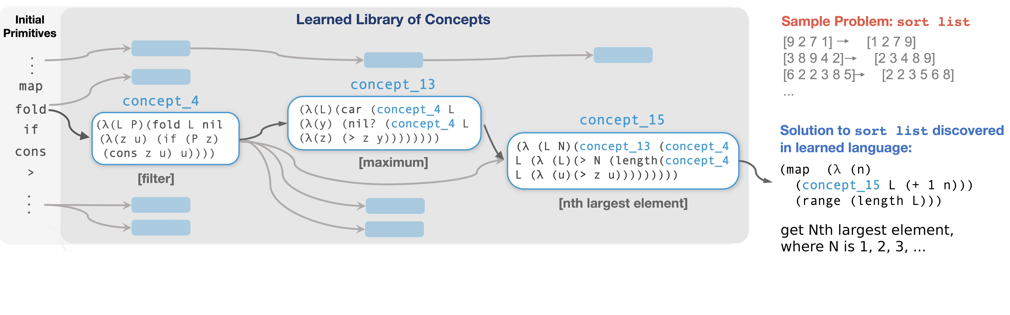
Library Learning in Dreamcoder
Solution rewritten in initial primitives:
(lambda (x) (map (lambda (y) (car (fold (fold x nil (lambda (z u) (if (gt? (+ y 1) (length (fold x nil (lambda (v w) (if (gt? z v) (cons v w) w))))) (cons z u) u))) nil (lambda (a b) (if (nil? (fold (fold x nil (lambda (c d) (if (gt? (+ y 1) (length (fold x nil (lambda (e f) (if (gt? c e) (cons e f) f))))) (cons c d) d))) nil (lambda (g h) (if (gt? g a) (cons g h) h)))) (cons a b) b))))) (range (length x))))

Slide 11
Library Learning in Dreamcoder
Induced sort program found in ≤ 10min.
Brute-force search without learned library would take ≈ 10⁷³ years

Slide 12
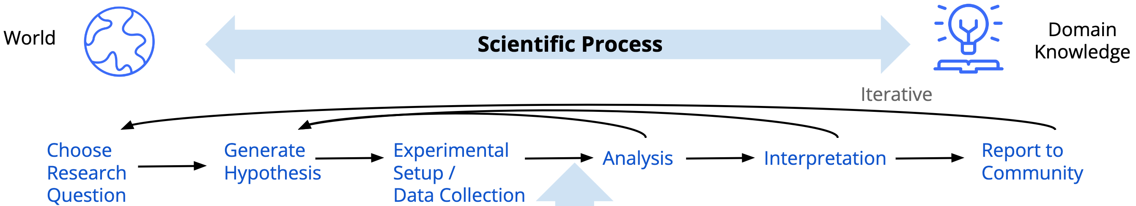



Notes:
So Let's begin with a birds eye view of the field.
In scientific discovery, our main goal is to make ML algorithms that can achieve human level performance at research in the natural sciences.
Now, as scientists, we have converged to a general roadmap for how to do research in the natural sciences called the scientific process. So practically, our goal in scientific discovery is to either automate or assist parts of these sub tasks.
Let's maybe work through a simple example of this

Slide 13
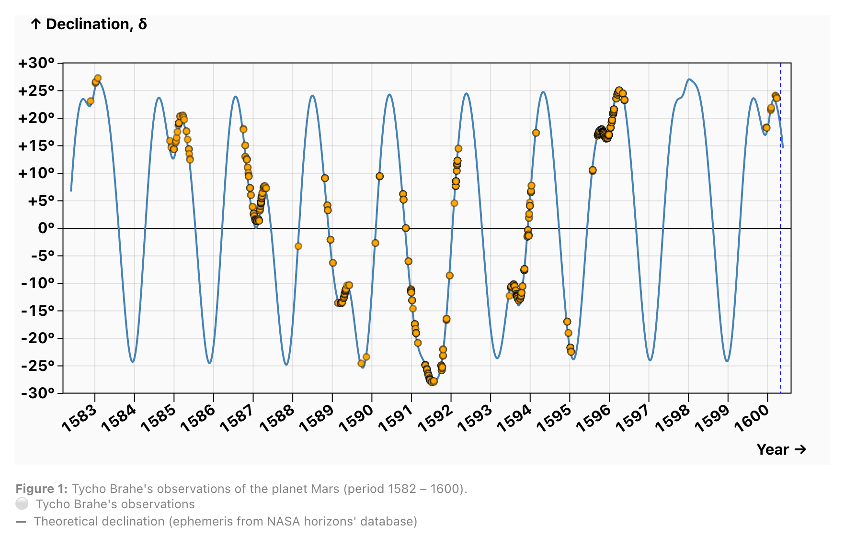

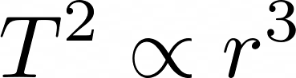
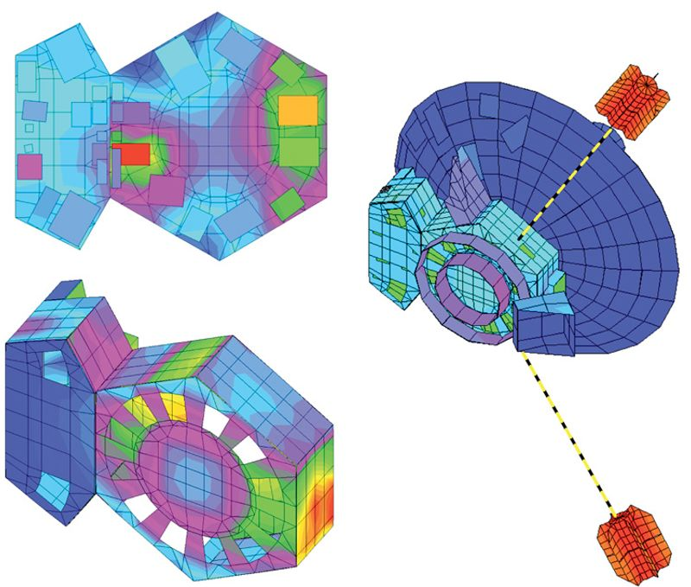
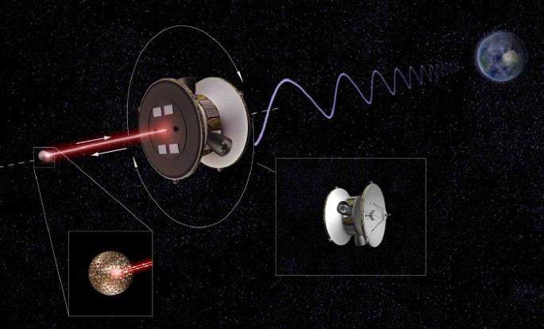
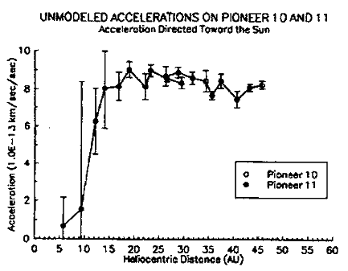

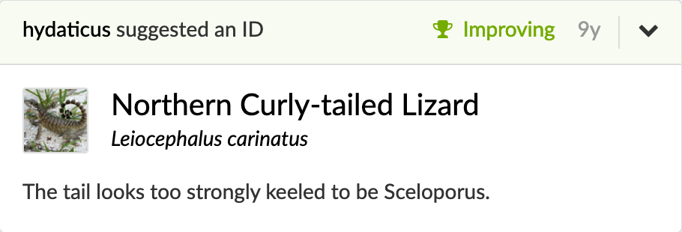
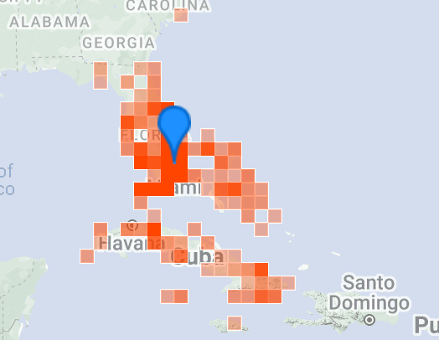
Apparent Retrograde Planetary Motion
Kepler’s Third Law
Rudolphine Tables
Pioneer Anomaly
iNaturalist Specie Identification
Notes:
So Let's begin with a birds eye view of the field.
In scientific discovery, our main goal is to make ML algorithms that can achieve human level performance at research in the natural sciences.
Now, as scientists, we have converged to a general roadmap for how to do research in the natural sciences called the scientific process. So practically, our goal in scientific discovery is to either automate or assist parts of these sub tasks.
Let's maybe work through a simple example of this

Slide 14
Lifecycle of a Scientific Process
Anomaly: Apparent Retrograde Planetary Motion
c.The Astronomical Revolution: Copernicus- Kepler-Borelli
Notes:
A long time ago our mathematical models were based on the sun and the planets revolving in circles around the earth.
However, astronomers noted that at times, the planets would disobey their celestial model and apparantly move backwards

Slide 15
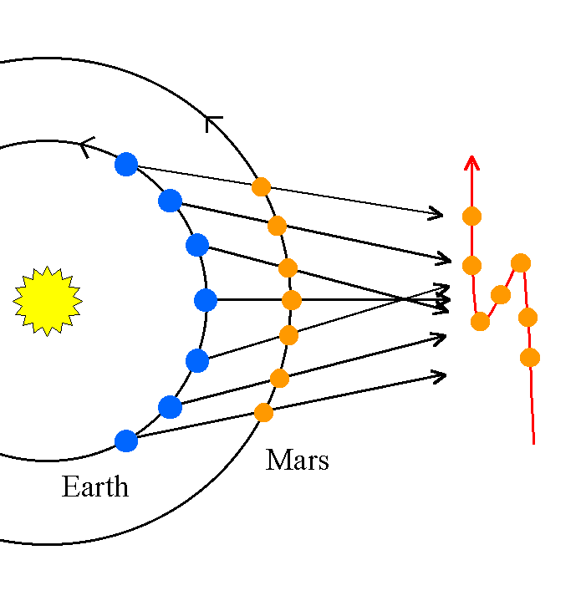
Lifecycle of a Scientific Process
Anomaly: Apparent Retrograde Planetary Motion Theory: Heliocentric Model
c.The Astronomical Revolution: Copernicus- Kepler-Borelli
Notes:
A theory was suggested to explain this phenomemon.
if the earth and the planets revolve around the sun. this motion becomes pretty obvious.
but you needed data to prove this hypothesis

Slide 16
Lifecycle of a Scientific Process
Anomaly: Apparent Retrograde Planetary Motion Theory: Heliocentric Model
Data Collection: Sample data in regime of interest.
c.The Astronomical Revolution: Copernicus- Kepler-Borelli
Notes:
So, about a 100 miles from here, scientists took the first precise measurements of the celestial bodies.

Slide 17
Lifecycle of a Scientific Process
Analysis: Kepler’s Third Law
Anomaly: Apparent Retrograde Planetary Motion Theory: Heliocentric Model
Data Collection: Sample data in regime of interest.
c.The Astronomical Revolution: Copernicus- Kepler-Borelli
Notes:
Kepler fit a lot of different geometric shapes to this data and found that the best fit equations had the planets moving in elliptical orbits.

Slide 18
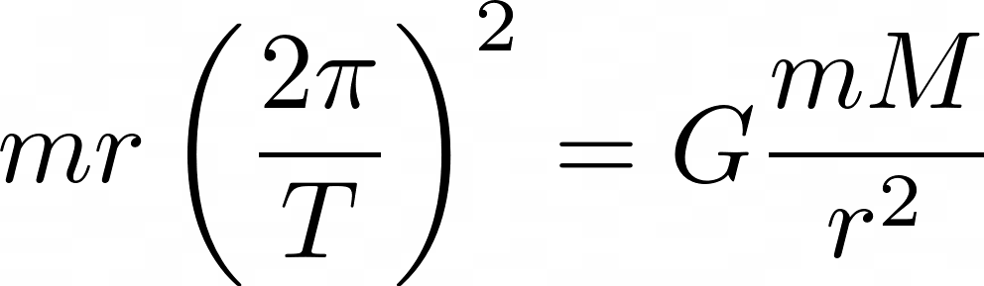
Lifecycle of a Scientific Process
Analysis: Kepler’s Third Law
Interpretation: Newton’s Law of Gravitation
Anomaly: Apparent Retrograde Planetary Motion Theory: Heliocentric Model
Data Collection: Sample data in regime of interest.
c.The Astronomical Revolution: Copernicus- Kepler-Borelli
Notes:
And then Newton used these empirical observations to motivate the basic laws of classical physics.
And this cycle would repeat itself 300 years later when we had better ways of measuring mercury's orbit and realized time dilation was a thing.

Slide 19
Goal: We want AI to achieve human level performance at research in the natural sciences.
Notes:
So Let's begin with a birds eye view of the field.
In scientific discovery, our main goal is to make ML algorithms that can achieve human level performance at research in the natural sciences.
Now, as scientists, we have converged to a general roadmap for how to do research in the natural sciences called the scientific process. So practically, our goal in scientific discovery is to either automate or assist parts of these sub tasks.
Let's maybe work through a simple example of this

Slide 20
Kepler’s Third Law
c. The Astronomical Revolution: Copernicus- Kepler-Borelli
Notes:
So Let's begin with a birds eye view of the field.
In scientific discovery, our main goal is to make ML algorithms that can achieve human level performance at research in the natural sciences.
Now, as scientists, we have converged to a general roadmap for how to do research in the natural sciences called the scientific process. So practically, our goal in scientific discovery is to either automate or assist parts of these sub tasks.
Let's maybe work through a simple example of this

Slide 21
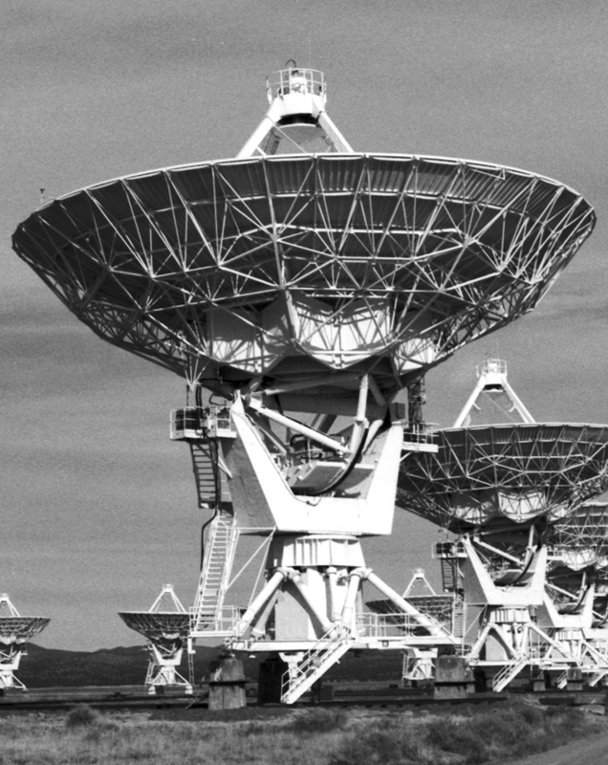
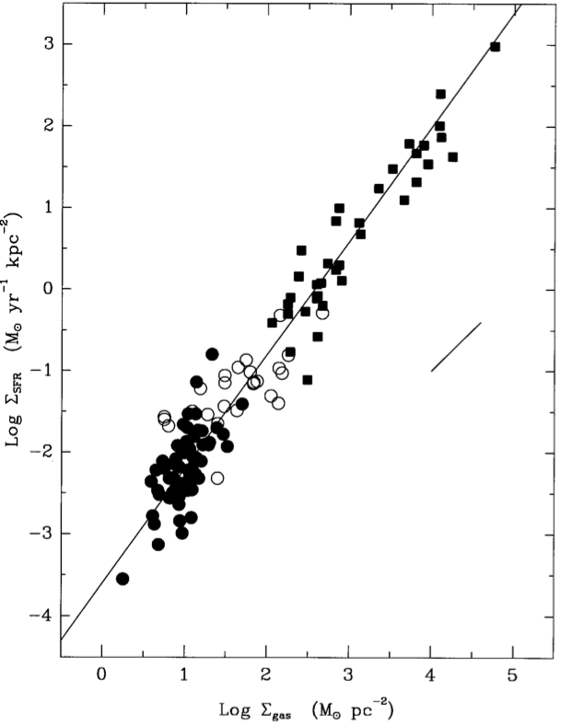
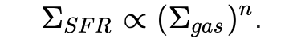
Kennicutt–Schmidt law
c. The Star Formation Law in Galactic Disks, Kennicutt (1989)
Notes:
So Let's begin with a birds eye view of the field.
In scientific discovery, our main goal is to make ML algorithms that can achieve human level performance at research in the natural sciences.
Now, as scientists, we have converged to a general roadmap for how to do research in the natural sciences called the scientific process. So practically, our goal in scientific discovery is to either automate or assist parts of these sub tasks.
Let's maybe work through a simple example of this

Slide 22
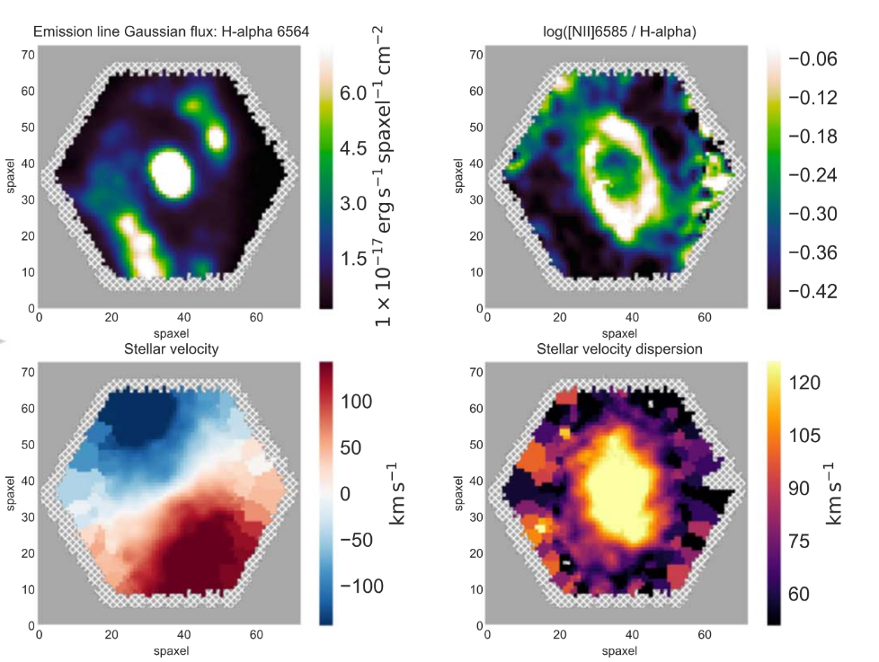
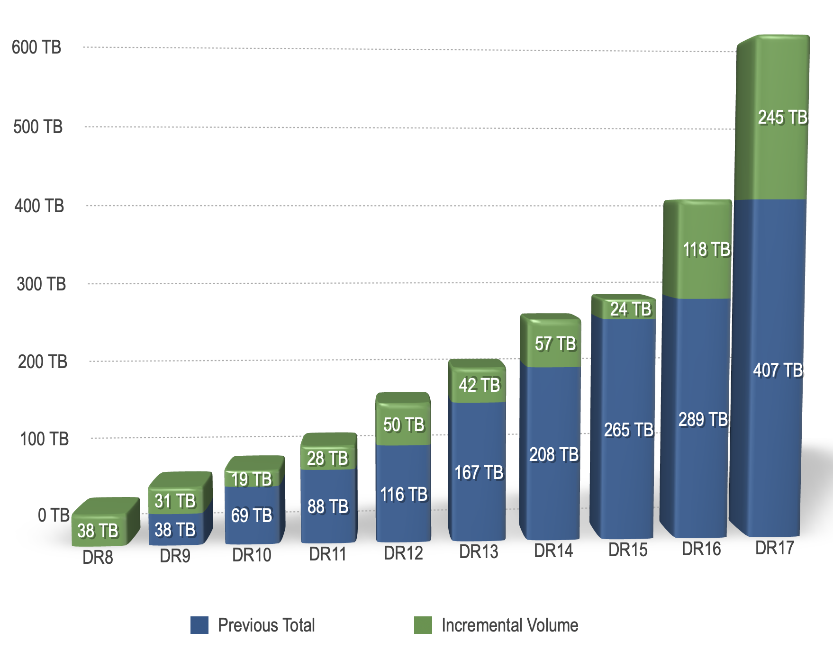
Manual Symbolic Regression cannot scale.
c. https://www.sdss4.org/dr17/data_access/volume/
Notes:
So Let's begin with a birds eye view of the field.
In scientific discovery, our main goal is to make ML algorithms that can achieve human level performance at research in the natural sciences.
Now, as scientists, we have converged to a general roadmap for how to do research in the natural sciences called the scientific process. So practically, our goal in scientific discovery is to either automate or assist parts of these sub tasks.
Let's maybe work through a simple example of this

Slide 23

Symbolic Regression Algorithms
c. PySR. Miles Cranmer
Notes:
Now, this is essentially the program synthesis problem where the DSL is the space of mathematical functions.
And the algorithms that work well here basically mimic the classical program synthesis techniques from 10 years ago. Why? Because the community has found that scale beats everything.
So, the algorithms I'm showing here is called PySR.
This is an evolutionary algorithm.
you start with a beginning candidate and randomly replace some parts of the expression
the expressions that perform well move into the next round
and the expressions that don't perform well die off.

Slide 24
Symbolic Regression Algorithms
c. PySR. Miles Cranmer
Notes:
However the name of the game here is still scale
you want to parallelize this across multiple CPUs and use a TON of resources until you hit your goal program

Slide 25
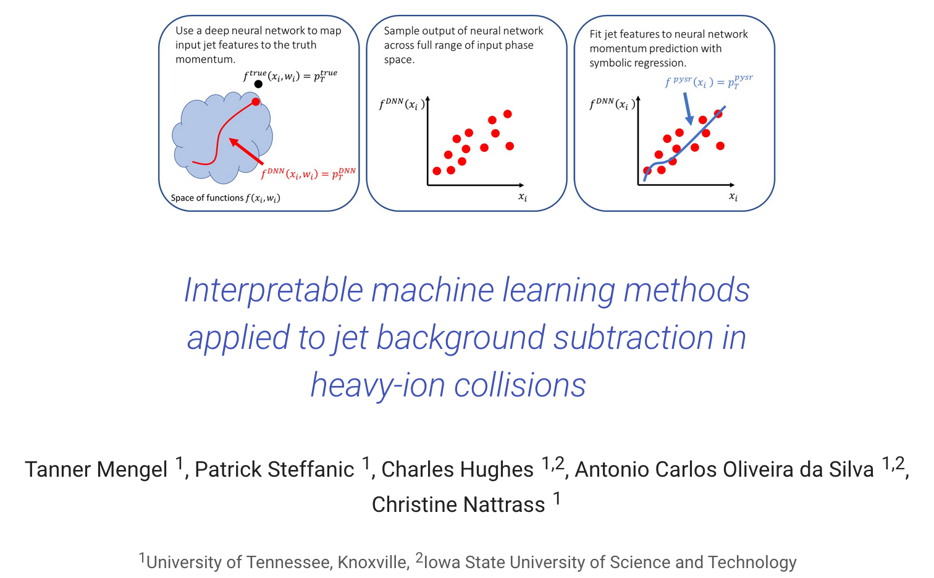
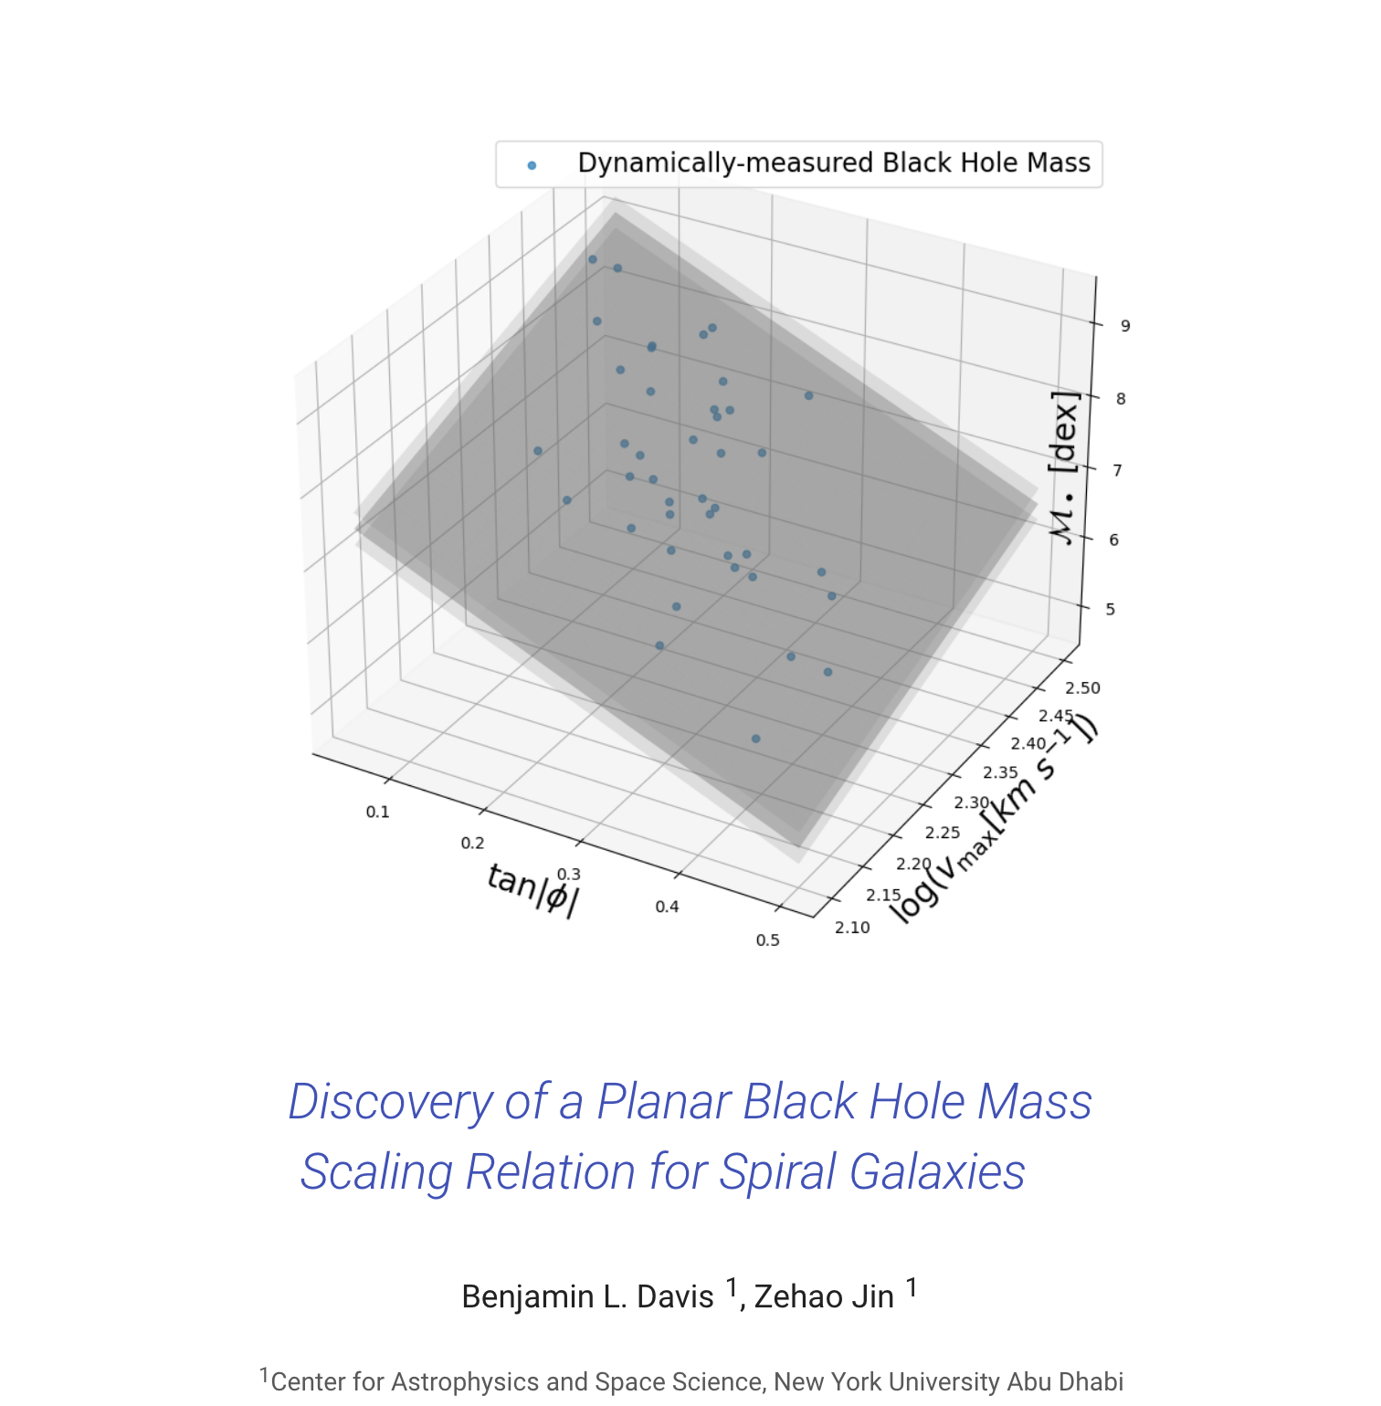
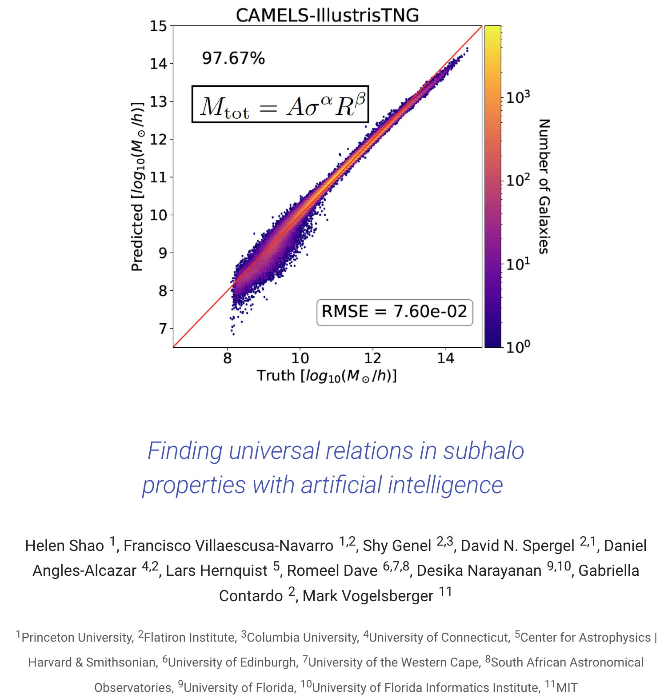
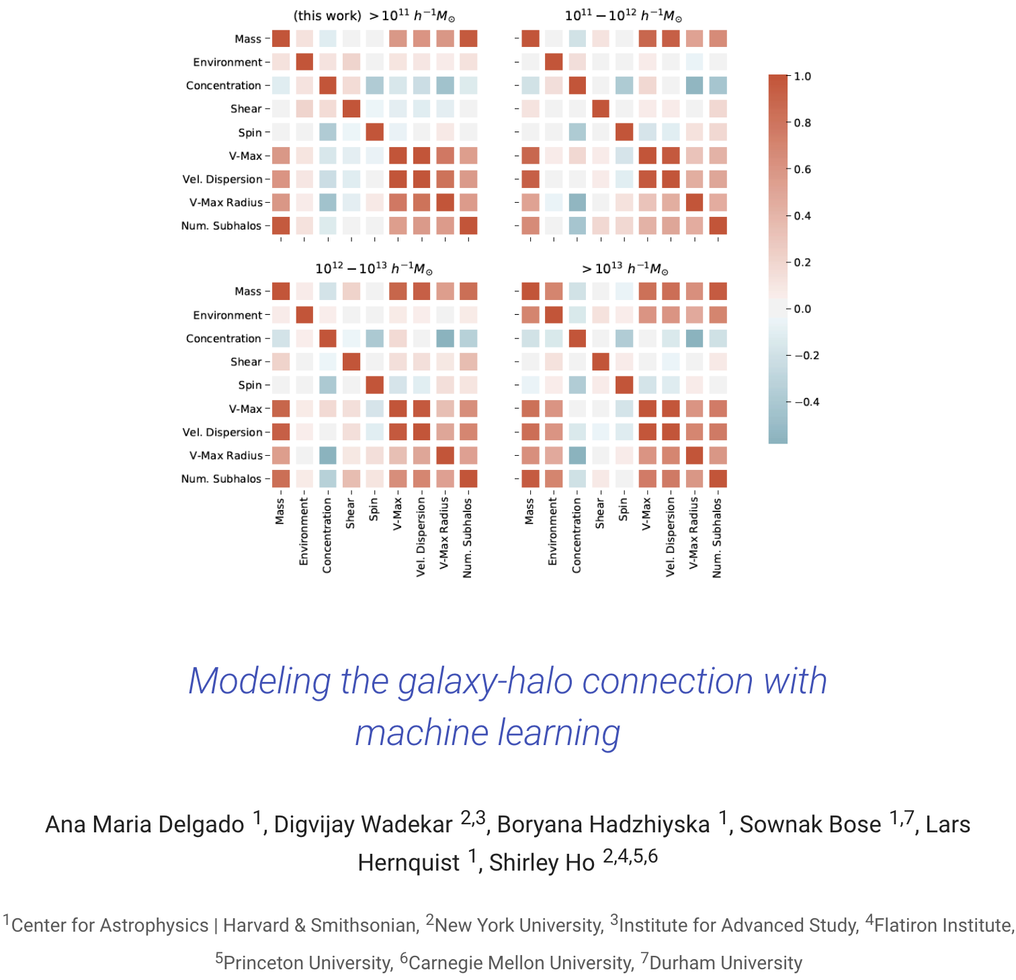
Symbolic Regression’s impact
c. PySR. Miles Cranmer
Notes:
and this is pretty successful
it's actually been used in real research for predicting black hole scaling laws, particle physics, geophysics you name it.

Slide 26
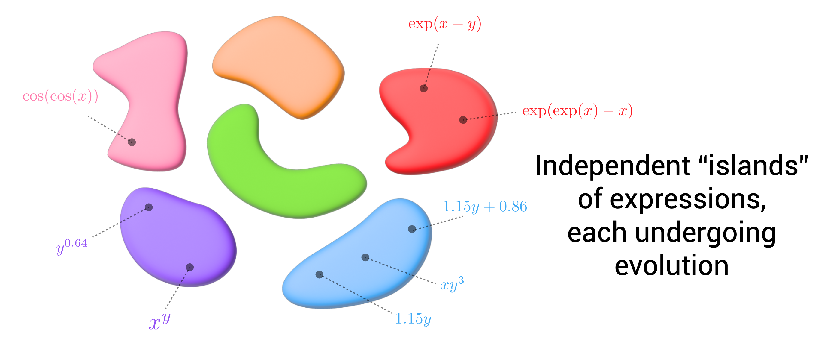
Sketch of PySR’s Exploration Space
c. PySR. Miles Cranmer
Notes:
but there are also a couple of problems with this strategy
I like to call evolutionary search a local search strategy because it only explores nodes that are syntactically closest to the initial node
and if you do this across multiple populations you end up with these islands basically
now PySR has heuristics to migrate programs across these islands but the core issue is you're using syntactic similarity to guide your search

Slide 27
Sketch of PySR’s Exploration Space
Goal: How can we increase exploration in relevant parts of the search space?
Notes:
This forms the motivation for our work.
Can we try to increase the exploration space of a program synthesis algorithm
And I want to emphasize that this syntactic enumeration strategy plagues a TON of classifcal program synthesis strategies.

Slide 28
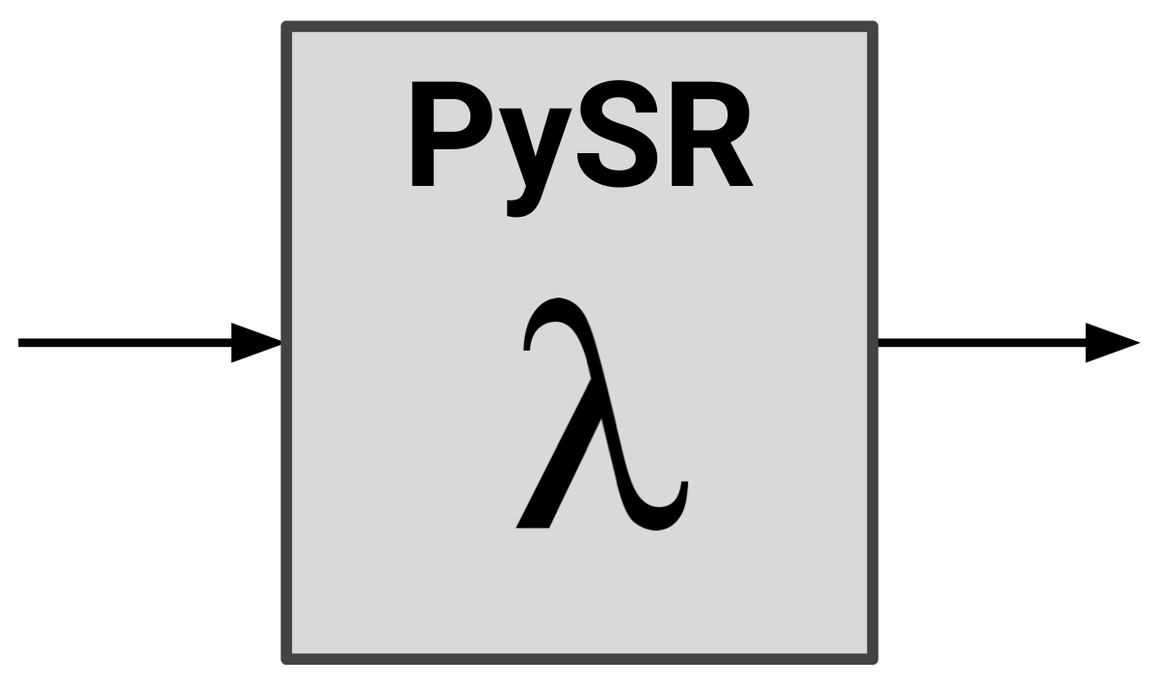
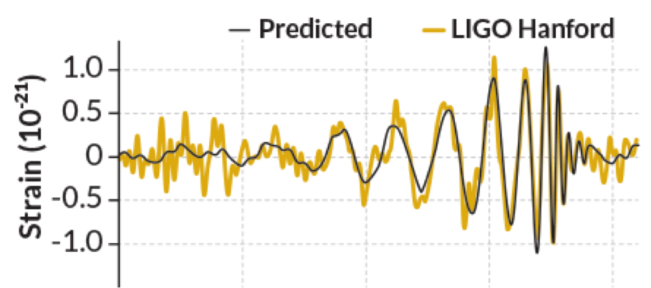
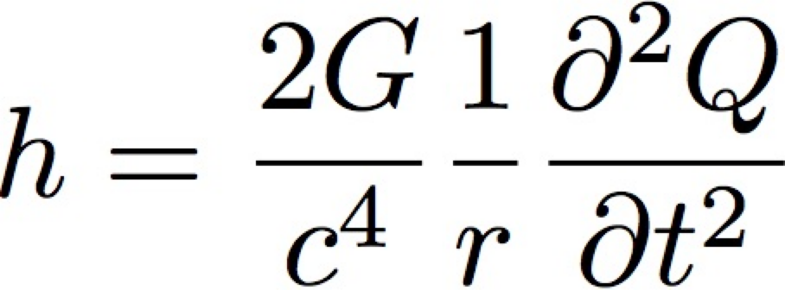
Issue 2: Specifying Inductive bias

Slide 29


LaSR: Flexible and Scalable Symbolic Regression
LaSR
Accelerate
“Wave strain diminishes as distance increases”
“Wave strain has extraordinarily small magnitude”
Concepts (by Physicist or LLM)
Visuals: Jennifer J. Sun
Notes:
The other desiderata of a concept is that it encodes some symbolic property of the target unknown equation.
For example, scientists that study gravity waves care a lot about finding the strain of a binary system as a function of the dipole moment and the distance between the poles.
This is a very complex equation and it will take a lot of compute to find this
but a scientist usually has a preconception of how certain variables will interact with each other. These preconceptions are going to also be concepts
and what we desire to do is to use these concepts to guide the search for this equation

Slide 30



LaSR: Symbolic Regression with a Learned Concept Library Arya Grayeli*, Atharva Sehgal*, Omar Costilla-Reyes, Miles Cranmer, Swarat Chaudhuri
https://trishullab.github.io/lasr-web
Notes:
So this work is called LaSR
and the main goal here is to keep track of a concept library.

Slide 31
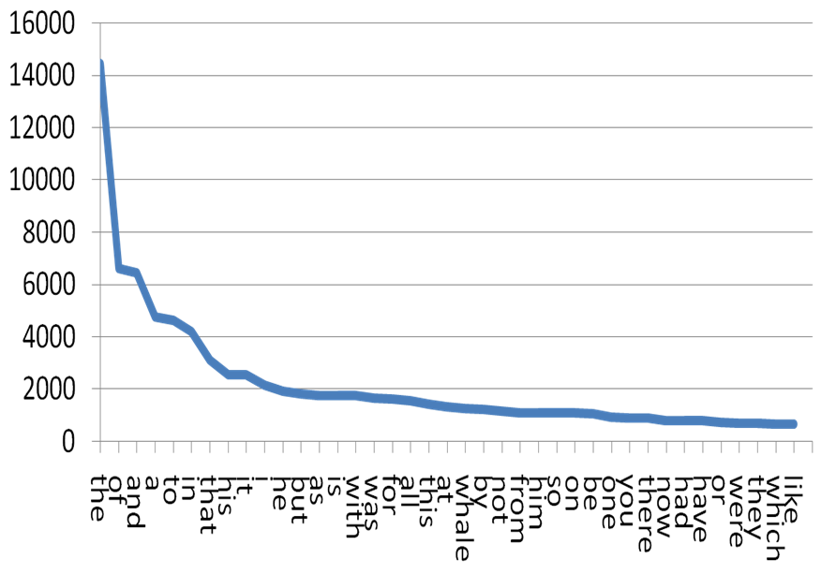
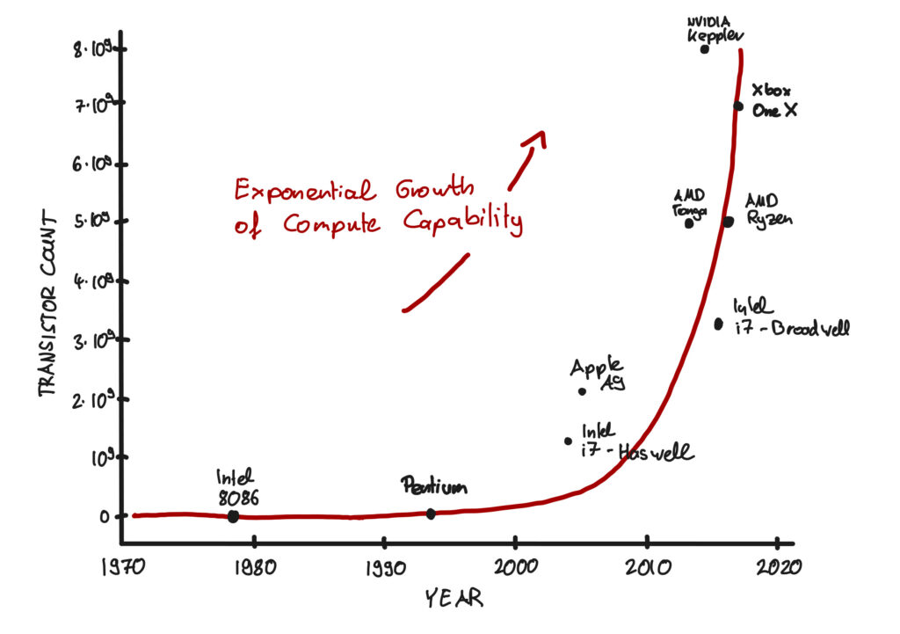
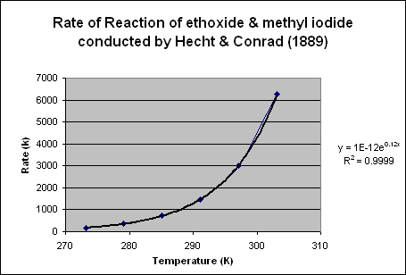
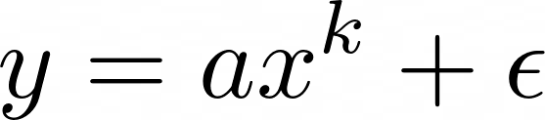
What is a Concept? Desiderata 1: Symbolic Abstraction
Zipf’s Law
Moore’s Law
Arrhenius’ Equation
⬄“Power Law Trend”
Notes:
Maybe a good place to begin is to start by defining what exactly is a concept. and for this I want to play a small game.
with your finger trace the general pattern of these equations. to make this simpler just draw the general pattern with your finger
and this trend punctuates many different disciplines in the natural sciences
and in general this is called a power law trend.
This is what I mean by a concept. A concept is a natural language sentence with that most importantly summarizes various mathematical equations.
And this is going to form the cornerstone and most important desiderata that we expect from a concept.

Slide 32
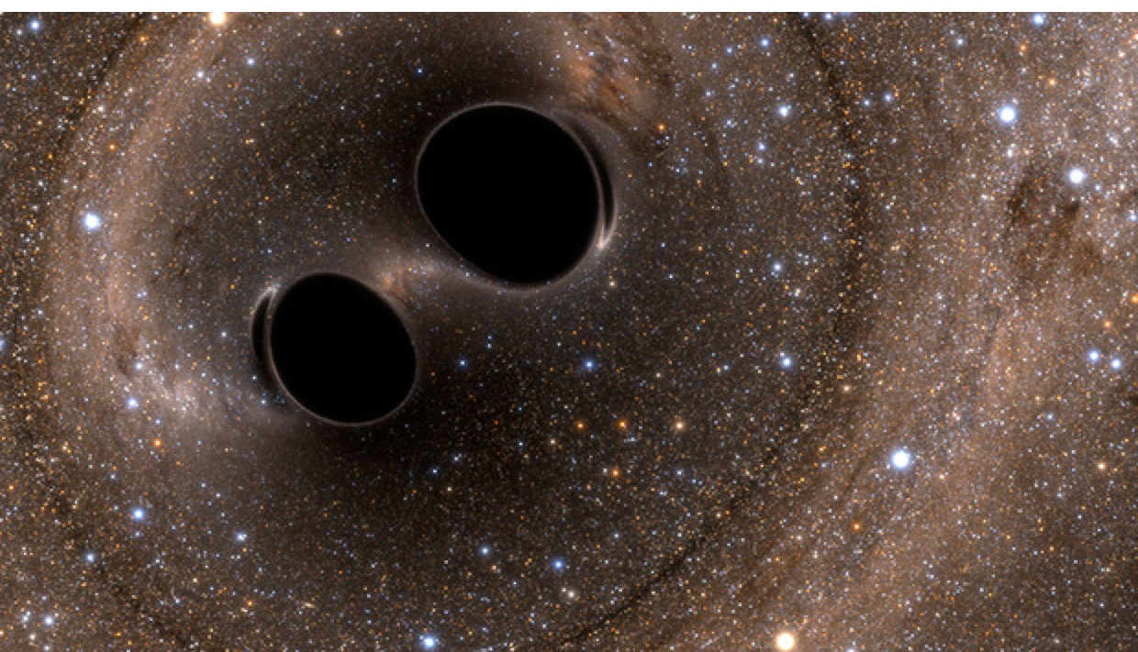
What is a Concept? Desiderata II : Symbolic Guidance
“Wave strain diminishes as distance increases”
“Wave strain has extraordinarily small magnitude”
Concepts (by Physicist or LLM)
Guide the
search for
Notes:
The other desiderata of a concept is that it encodes some symbolic property of the target unknown equation.
For example, scientists that study gravity waves care a lot about finding the strain of a binary system as a function of the dipole moment and the distance between the poles.
This is a very complex equation and it will take a lot of compute to find this
but a scientist usually has a preconception of how certain variables will interact with each other. These preconceptions are going to also be concepts
and what we desire to do is to use these concepts to guide the search for this equation

Slide 33
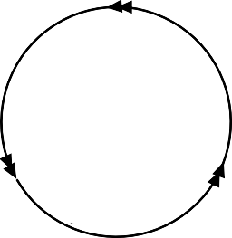


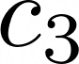
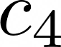
LaSR
Hypothesis Evolution
Concept Evolution
Concept Abstraction
Hypothesis
Evolution
Concept Library
Concept Evolution
Concept Abstraction
Notes:
Anyway putting it all together.
Our algorithm will have three distinct phases

Slide 34

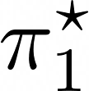
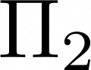
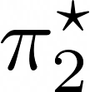
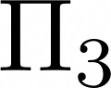
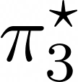
LaSR
Hypothesis Evolution
LLM Evolution provides neural guidance (over a language prior)
Hypothesis Populations
Dataset
Concept Library
Best Hypothesis per Population
Symbolic Evolution
LLM Evolution
or
For 10⁶ operations
Concept Evolution
Concept Abstraction
Hypothesis
Evolution
Concept Library
Concept Evolution
Concept Abstraction
Notes:
First we're going to find the best possible programs. We’ve already talked about this part.
The essential idea here is that symbolic evolution is finding syntactically similar programs
while LLM evolution is doping the populations with semantically similar programs.

Slide 35
Hypothesis Evolution
Mutation
Symbolic Mutation
Crossover
Symbolic Crossover
Program
Population
Best Program
Initialization
Other Symbolic Operations
Symbolic Initialize
Evaluate
Optimize Constants
Simplify Tree
Replace Oldest
x300 times
Notes:
How do we go about doing that.
Super simple.
What I'm showing here is the order of operations for PySR and everything in gray is the PySR programs.
(GO THROUGH A LOOP)
What we're going to do is 1% of the time when PySR calls mutation or crossover, we're going to fire a query to an LLM instead.

Slide 36
Hypothesis Evolution
Mutation
Symbolic Mutation
or
LLM Mutation
Crossover
Symbolic Crossover
or
LLM Crossover
Program
Population
Best Program
Initialization
Other Symbolic Operations
Symbolic Initialize
LLM Initialize
Evaluate
Optimize Constants
Simplify Tree
or
Replace Oldest
x300 times
Notes:
How do we go about doing that.
Super simple.
What I'm showing here is the order of operations for PySR and everything in gray is the PySR programs.
(GO THROUGH A LOOP)
What we're going to do is 1% of the time when PySR calls mutation or crossover, we're going to fire a query to an LLM instead.

Slide 37
Hypothesis Evolution
Mutation
Concept Library
Symbolic Mutation
or
LLM Mutation
Crossover
Symbolic Crossover
or
LLM Crossover
Program
Population
Best Program
Initialization
Other Symbolic Operations
Symbolic Initialize
LLM Initialize
Evaluate
Optimize Constants
Simplify Tree
or
Replace Oldest
x300 times
Notes:
These LLM queries are going to be different from the symbolic queries because we’re going to try to query programs that are semantically similar to concepts in the concept library

Slide 38
Hypothesis Evolution
import random
def crossover(
expr1: SymTree,
expr2: SymTree) -> SymTree:
# Randomly choose a node in expr1 to remove
...
# Randomly choose a node in expr2 which will be added to eq1
...
# Return new tree
new_expr = ...
return new_expr
Mutation
Concept Library
Symbolic Mutation
or
LLM Mutation
Crossover
Symbolic Crossover
or
LLM Crossover
Program
Population
Best Program
Initialization
Other Symbolic Operations
Symbolic Initialize
LLM Initialize
Evaluate
Optimize Constants
Simplify Tree
or
Replace Oldest
x300 times
Notes:
Here is what the implementation for a Symbolic operation looks like. This is called a crossover and we’re randomly replacing some of the operations in the topmost program with operations in the second best program.
I want to point out that the actual implementation in the codebase is pretty complex and you can tell a lot of care went into making this as fast as possible
In fact the codebase is mostly in Julia not Python so its even faster.
Here is what the LLM crossover operation looks like if you were wondering.

Slide 39
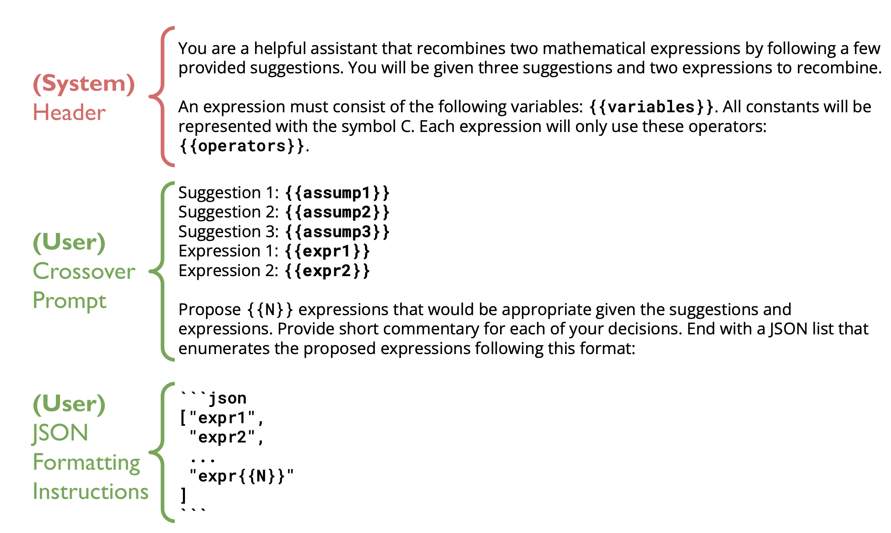
Hypothesis Evolution
Mutation
Concept Library
Symbolic Mutation
or
LLM Mutation
Crossover
Symbolic Crossover
or
LLM Crossover
Program
Population
Best Program
Initialization
Other Symbolic Operations
Symbolic Initialize
LLM Initialize
Evaluate
Optimize Constants
Simplify Tree
or
Replace Oldest
x300 times
Notes:
The only notable thing that seperates this from a normal chatGPT query is that we're also feeding in a couple of concepts here with the hope that the output programs bear some semantic similarity to the given suggestions
This is a pretty naive LLM query implementation possible. and all our prompts are similarly simple. I think there is a lot of work that has been done and that can be done to improve the inference process here.

Slide 40
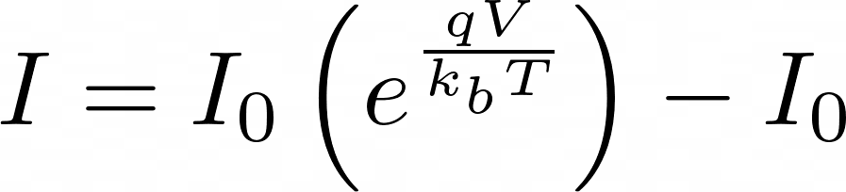
LaSR
Hypothesis Evolution
Hypothesis Populations
Dataset
Concept Library
Best Hypothesis per Population
LLM Abstraction induces useful* abstractions.
Symbolic Evolution
LLM Evolution
or
For 10⁶ operations
Concept Evolution
Concept Abstraction
Hypothesis
Evolution
Concept Library
LLM Abstraction
Concept Evolution
Concept Abstraction
“exponential growth/decay”
Notes:
Next we're going to look at the best performing programs and summarize them into concepts.
LLMs are great at summarizing small functions and there is a ton of techniques in how to do this right

Slide 41

LaSR
Hypothesis Evolution
Hypothesis Populations
Dataset
Concept Library
Best Hypothesis per Population
LLM Concept Crossover evolves all concepts.
Symbolic Evolution
LLM Evolution
or
For 10⁶ operations
Concept Evolution
Concept Abstraction
“exponential growth/decay”
Hypothesis
Evolution
“Depends on temperature”
Concept Library
LLM Abstraction
LLM Concept Crossover
Concept Evolution
Concept Abstraction
“exponential growth/decay”
“Boltzmann Distribution”
Notes:
Finally, we can evolve our concepts too. For example you might have some concepts that are natural progression of other known concepts and the idea here is to discover those features.
And then the loop repeats itself.
Each iteration is self amplifying. So the concepts you sample help explore more interesting programs, and the programs help find even more interesting concepts which evolve to find even more interesting concepts. And so on.

Slide 42
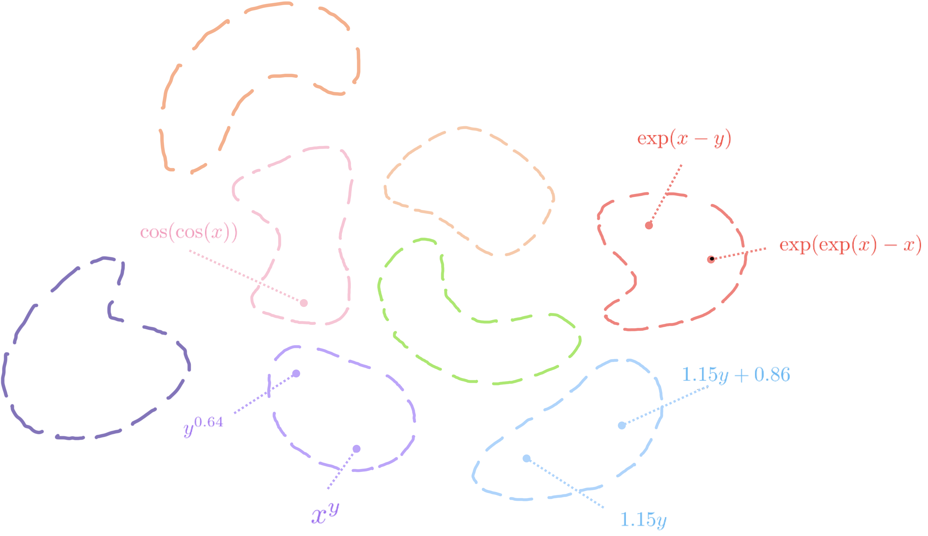
Sketch of Search Space
After Phase 1: “Islands” of expressions
Notes:
Here is what the search space looks like. Remember we started off with these islands in PySR.

Slide 43
Sketch of Search Space
After Phase 2: Concepts for each “Island”
Sinusoidal Trends
Exponential Trends
Linear Trends
Power Law Trends
Notes:
Here is what the search space looks like. Remember we started off with these islands in PySR.

Slide 44
Sketch of Search Space
After Phase 2: Concepts expose unknown islands
Sinusoidal Trends
Exponential Trends
Linear Trends
Power Law Trends
Notes:
Here is what the search space looks like. Remember we started off with these islands in PySR.

Slide 45
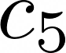
Sketch of Search Space
After Phase 3: Concepts expose new concepts.
Sinusoidal Trends
Exponential Trends
Trignometric
Trends
Linear Trends
Power Law Trends
Notes:
Here is what the search space looks like. Remember we started off with these islands in PySR.

Slide 46
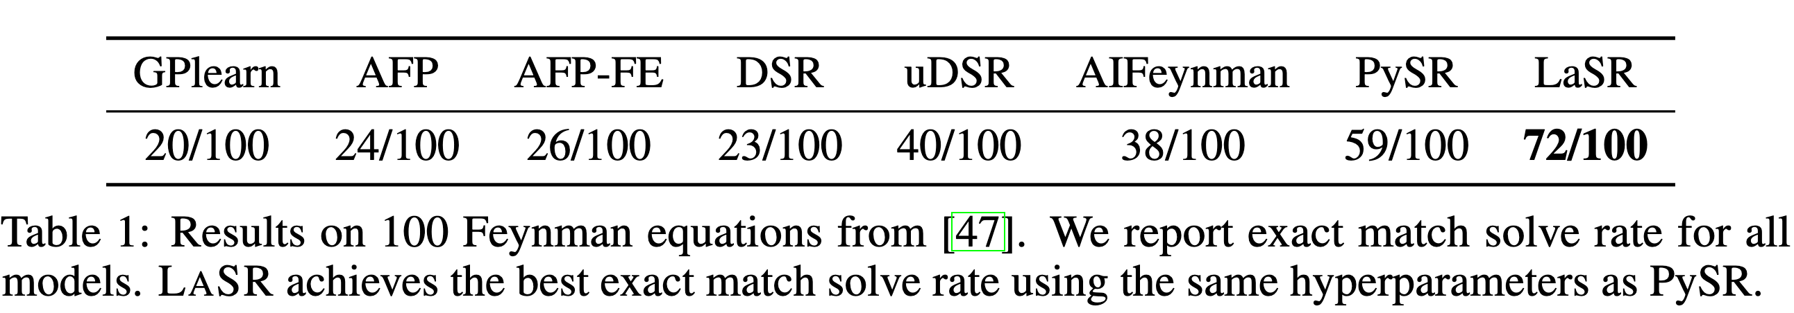

LaSR Results I - Performance
Concept Guidance accelerates scientific discovery.
LaSR outperforms PySR even with local language models (llama-3-7b, 1%)

Slide 47

LaSR Results II - Hints
User provided hints accelerate hypothesis search

Slide 48


Results III - Case Study
Eq 10: Coulomb's Law
Inverse Square Law
Directly proportional to charges
Force symmetric w.r.t charges
PySR’s Solution
Reduces to ground truth after 10 steps of simplification.
Unwieldly
Fitting more constants => more optimization errors

Slide 49

Results III - Case Study
Eq 10: Coulomb's Law
Inverse Square Law
Directly proportional to charges
Force symmetric w.r.t charges
LaSR’s Solution
Reduces to ground truth after 4 steps of simplification
Smaller models synthesize simpler equations!

Slide 50
Results III - Case Study
Iteration | Discovered Concept
2 | The good mathematical expressions exhibit […] with a focus on power functions and trigonometric functions […]
6 | The good mathematical expressions exhibit […] symmetry or regularity […]
24 | The good mathematical expressions have […] with a specific pattern of division and multiplication
Eq 10: Coulomb's Law
Inverse Square Law
Directly proportional to charges
Force symmetric w.r.t charges
LaSR’s Concepts (Limitations)
Cannot guarantee factuality or correctness.
Good concepts depend on LLM training. Concepts can mislead scientists.

Slide 51


Finding LLM Scaling Laws
Step 1: Postulate Scaling Law
Step 2: Measure model loss w.r.t hyper parameters.
Google DeepMind MassiveText
Step 3: Fit scaling law to dataset.
Training Compute-Optimal Large Language Models, Hoffman et. al

Slide 52

Finding LLM Scaling Laws with LaSR
Google DeepMind BIG-Bench
(204 tasks, 55 LLMs, )
Step 1: Measure model loss w.r.t hyper parameters.
LaSR
Step 2: Use symbolic regression to postulate and fit scaling laws
Step 3: Choose the scaling law that fits the data the best while using the least parameters.
Training Compute-Optimal Large Language Models, Hoffman et. al

Slide 53
LLM Scaling Law

Slide 54


Discovering New Empirical Laws (Prelim)
Cosmology Problem: How does the distribution of matter in galaxies change as they age?
Discovered Law
redshift

Slide 56


Qualitative Traits
Interaction between training hyper params (#steps) and testing hyper params (#shots)
We can modify Chinchilla using empirical insights

Slide 57

Qualitative Traits

Slide 58
Outline of this Talk
Scientific Discovery
Symbolic Regression
Symbolic Regression with a Concept Library (NeurIPS’24)
Visual Reasoning
Self-Evolving Visual Concept Library using Vision-Language Critics (CVPR’25)
Discussion
Notes:
I’ve structured this talk into four sub parts
The scientific discovery problem is a bit different from the general theorem proving formulation so I want to spend some time motivating scientific discovery and talk about the kind of program synthesis search algorithms in this space. (10 min)
Next, I want to talk about one way of guiding the symbolic search with LLMs. ( 15 min)
We’ll talk a little bit about some ongoing work on visual reasoning with neurosymbolic program (5 min)
And I’ll take questions at the end (10 min)

Slide 59
Recap: Symbolic Regression
Kepler’s Third Law
Notes:
One problem with this formulation is that we’re assuming that we already know what the relevant variables are. Someone has already done the heavy work of taking observations and presenting only the relevant variables.

Slide 60

Visual Reasoning
https://www.inaturalist.org/observations/1970016
Observation: Geolocated Picture
Theory: Crowdsourced identification
Data: Geotagged sightings
Notes:
I want to move on to the problem of collecting relevant data when we do not know exactly what we’re looking for.
herpetologist

Slide 61



Visual Programming
“Is there a helmet in this picture that is not blue?”
“Is there a helmet in this picture that is not blue?”
Visual Program
Large monolithic model
GPT4o
“yes”
“no”
Notes:
I want to move on to the problem of collecting relevant data when we do not know exactly what we’re looking for.

Slide 62
c. VisProg. Gupta et. al
Notes:
Surf Scoter eating a clam

Slide 63

Intermediate descriptors are powerful programs
def is_eagle(image):
image_patch = ImagePatch(image)
if not image_patch.exists('bird'):
return 'no'
eagle_patch = image_patch.find('bird')[0]
eagle_features = [
"large wings",
"large beak",
"white head",
"black body"
]
p_eagle = 0.0
for feature in eagle_features:
p_eagle += eagle_patch.exists(feature)
p_eagle /= len(eagle_features)
return 'yes' if p_eagle >= 0.75 else 'no'
Is this an image of an adult bald eagle?
LLM

Slide 64
Intermediate descriptors are powerful programs
def is_eagle(image):
image_patch = ImagePatch(image)
if not image_patch.exists('bird'):
return 'no'
eagle_patch = image_patch.find('bird')[0]
eagle_features = [
"large wings",
"large beak",
"white head",
"black body"
]
p_eagle = 0.0
for feature in eagle_features:
p_eagle += eagle_patch.exists(feature)
p_eagle /= len(eagle_features)
return 'yes' if p_eagle >= 0.75 else 'no'
Can we automatically discover these
visual descriptors?
"large wings",
"large beak",
"white head",
"black body"
Is this an image of an adult bald eagle?
GPT

Slide 65

Escher: Self-Evolving Visual Concept Library using Vision-Language Critics Atharva Sehgal, Patrick Yuan, Ziniu Hu, Yisong Yue, Jennifer J. Sun, Swarat Chaudhuri
https://trishullab.github.io/escher-web
Notes:
So this work is called LaSR
and the main goal here is to keep track of a concept library.

Slide 66


Slide 76


Feedback generation
LLM

Slide 79
Key insight: The concept library is simultaneously bootstrapping the VLM inputs and the LLM inputs.

Slide 80



Results
Without any human intervention, evolving multiple CBM algorithms with Escher yields state of the art performance.
Naively sampling labels from an LLM does not help; feedback from visual critic is key.

Slide 81




Qualitative Results
With no iterations, the model confuses this for a Female Ring-necked pheasant because:
While the true class has lower aggregate activation because:
After 5 iteration with Escher, the model predicts this as an Male Ring-necked pheasant because:
This is a Male Ring-necked pheasant.

Slide 82
Qualitative Results
With no iterations, the model confuses this for a Female Ring-necked pheasant because:
While the true class has lower aggregate activation because:
After 5 iteration with Escher, the model predicts this as an Male Ring-necked pheasant because:
This is a Male Ring-necked pheasant.

Slide 83
Outline of this Talk
Scientific Discovery
Symbolic Regression
Symbolic Regression with a Concept Library (NeurIPS’24)
Visual Reasoning
Self-Evolving Visual Concept Library using Vision-Language Critics (CVPR’25)
Discussion
Notes:
I’ve structured this talk into four sub parts
The scientific discovery problem is a bit different from the general theorem proving formulation so I want to spend some time motivating scientific discovery and talk about the kind of program synthesis search algorithms in this space. (10 min)
Next, I want to talk about one way of guiding the symbolic search with LLMs. ( 15 min)
We’ll talk a little bit about some ongoing work on visual reasoning with neurosymbolic program (5 min)
And I’ll take questions at the end (10 min)

Slide 84



Discussion: Learning to learn from foundation models?
Organoids analyzed using DinoV2
https://openai.com/index/weak-to-strong-generalization/

